Slide 1










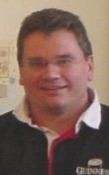





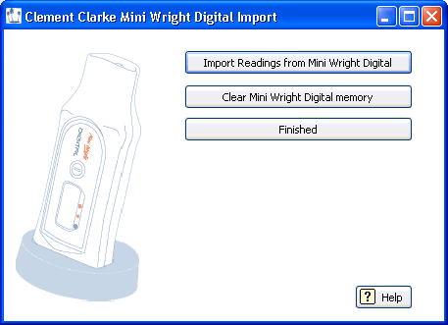
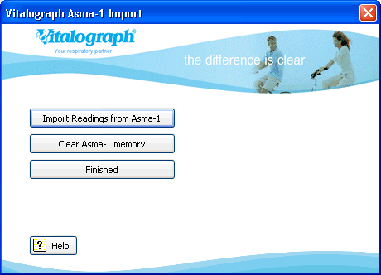
Oasys Internet database
Oasys
Funding
Occupational asthma
Occupational asthma is the commonest lung disease and stops skilled people working mid-career, at an estimated cost of £1.1 billion over the next 10 years (HSE). About 15% of adult onset asthma is caused by exposures at work (BOHRF UK occupational asthma guidelines, 2010).
Diagnosis of Occupational Asthma
The diagnosis of occupational asthma is difficult and previously beyond the resources of most lung function and occupational health departments. Only around 1 in 10 people with occupational asthma receive a diagnosis. A recent survey showed that only 15% of departments were able to offer diagnostic tests complying with the BTS standards of care (Occupational Medicine, 2008).
Oasys
The Oasys computer program analyses serial peak flow records for signs of occupational asthma. It has a sensitivity of 77% and specificity of 93% (Thorax, 2009), better than any other validated test for occupational asthma. Diagnosing occupational asthma with Oasys is cheap and easy.
Oasys has teamed up with 2 meter manufacturers, Clement Clarke and Vitalograph, to provide automatic downloading of data into the program. As manual data entry takes around 30 minutes this gives the meters a competitive advantage and Oasys receives a portion of the sale price.
This funding solution allows us to give Oasys away for free, which will be especially important in developing countries.
Meters that download automatically provide a cost saving for the NHS and any other companies / organisations in developed countries, while still allowing Oasys to receive income and the meter manufacturers to turn a profit.
The meter manufacturers will use their advertising and marketing muscle to promote their new Oasys compatible meters. This will increase awareness of occupational asthma and Oasys, improving the rate of diagnosis.
Internet database
Oasys Team
The Internet Database stores the anonymous parts of all records analysed using Oasys. This allows us to provide billing and usage information to meter manufacturers and will become the biggest repository of serial peak flow records globally. We also intend to use this for audit and research purposes. We hope it will become the primary barometer of the fight against occupational asthma.
Step 1: Data collection
Step 3: Analyse
Oasys provides a wide variety of graphs to aid visual analysis and scores for computer based analysis. These are the Oasys 2 score, the ABC score and the timepoint score.
Patients are asked to record their peak flow, every 2 hours from waking up until going to bed, for four weeks.
Step 2: Data entry
Data can be downloaded automatically by using a meter from one of our partners.
Alternatively data can be entered manually, which takes around 30 minutes per record.
www.occupationalasthma.com

